Slide 1
COMP 6065 ARTIFICIAL INTELLIGENCE – FINAL PROJECT
Pacman | Thedy Dinata | 1901531054

Slide 2
Pacman
Automated / User controlled Pacman game

Slide 3
Pacman – Tools and Strategy
Search
Multi-agent Search
Reinforcement Learning
Python 2.7
Tkinter

Slide 4
Search
Pacman agent will find paths through his maze world, both to reach a particular location and to collect food efficiently.

Slide 5
Multi-agent Search
design agents for the classic version of Pacman, including ghosts.
implement minimax search

Slide 6
Reinforcement Learning
implement value iteration and Q-learning
test agents first on Gridworld (from class), then apply them to a simulated robot controller (Crawler) and Pacman.

Slide 7

Python 2.7
interpreted, object-oriented, high-level programming language with dynamic semantics.

Slide 8

Tkinter
Python's de-facto standard GUI (Graphical User Interface) package.

Slide 9
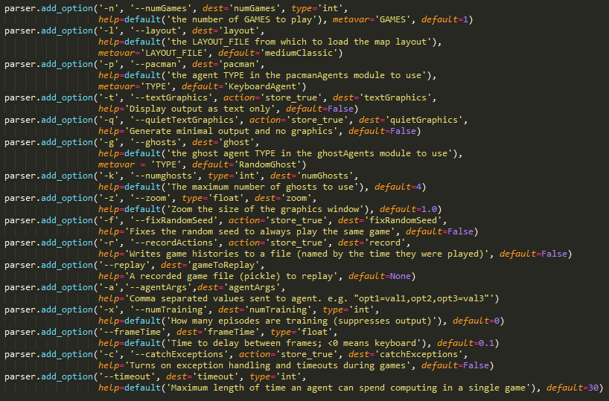
Arguments that need to be inputted
If no arguments, or arguments inputted but –p (pacmanAgent) are not inputted, the game will be playable by User.

Slide 10
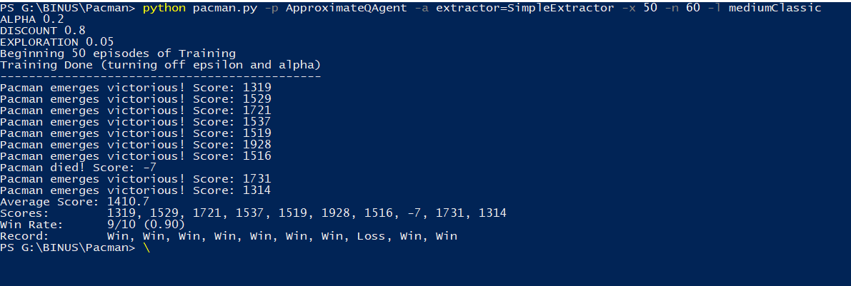
When Running Code

Slide 11
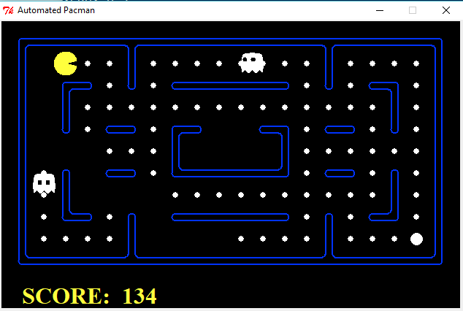
When Training is Done – GUI

Slide 12
Thank you

